Slide 1
25.06.02
건강검진, 문진 활용 암 기저 위험도 예측
모형 개발

Slide 2
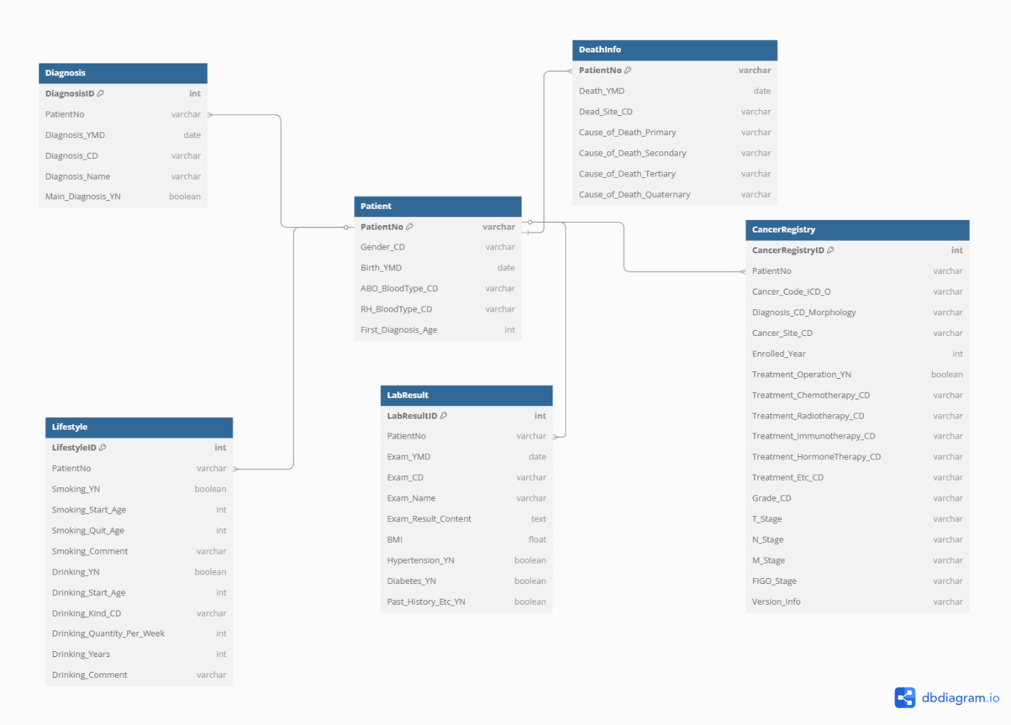

Slide 3
문진 데이터를 통한 암종별 확률
1차 2536명 진행
Feature Selection
Risk Stratification
Output(예시)
Single variable Signfiicant Test
Simple Model
P(위암)=0.3,
P(대장암)=0.05,
P(난소암)=0.1,
P(폐암)=0.4,
P(정상) = 0.1
기본정보
성별, 연령, 혈액형
Chi-square Test
Data Preprocessing
(One-hot Encoding)
Naïve Bayes Classifier
Mutual Importance
생활습관
음주/흡연 상세 기록, 운동 여부, BMI
Logistic Regression with L1 Regularization
Softmax Regression
Knock-off Selection
(False Detection Rate)
질병 과거력
Complex Model
MLP
판별력 (Discrimination)
Tree-Based Importance
Sigmoid 출력 함수
AUC
보정 (Calibration)
Calibration Curve

Slide 4
Feature Selection And Engineering
Feature Selection
Risk Stratification
Output(예시)
기본정보
성별, 연령, 혈액형
Data Preprocessing
(One-hot Encoding)
Single variable Signfiicant Test
Simple Model
P(위암)=0.3,
P(대장암)=0.05,
P(난소암)=0.1,
P(폐암)=0.4,
P(정상) = 0.1
Chi-square Test
생활습관
음주/흡연 상세 기록, 운동 여부, BMI
Naïve Bayes Classifier
Mutual Importance
질병 과거력
Logistic Regression with L1 Regularization
Softmax Regression
Data Preprocessing
(Normalization)
Knock-off Selection
(False Detection Rate)
Complex Model
CBC Data
Tree-Based Importance
MLP
판별력 (Discrimination)
Sigmoid 출력 함수
AUC
보정 (Calibration)
Calibration Curve

Slide 5
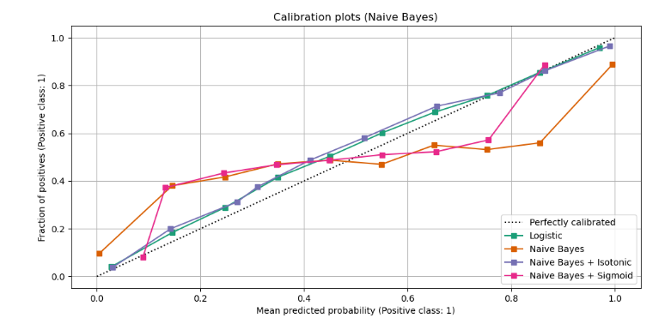
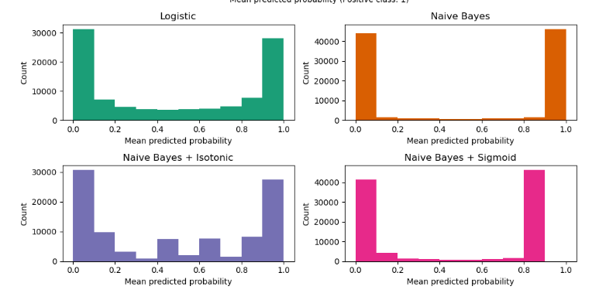

Slide 6
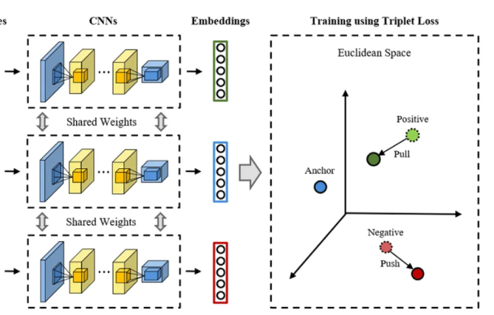
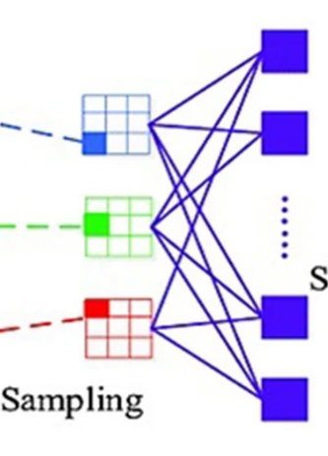
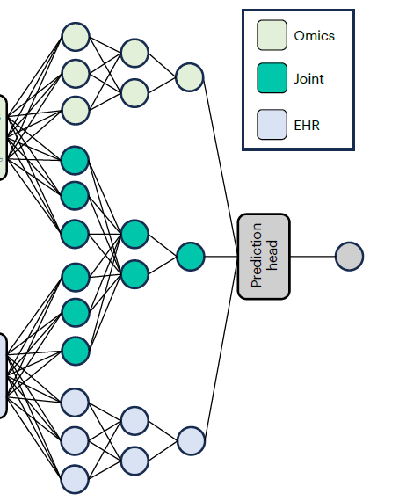

Part 1
Deep Metric Learning
제목을 입력하세요
Input
암종 A 환자 A
oral cancer,
pancreatic cancer,
gastric cancer,
Lung cancer kidney cancer
158087 persons
CBC Data
Survey Data
암종 A 환자 B
건강한 환자 혹은 암종 환자 C
5종
분류 학습기
972명
Gastric Cancer
Fully connected Layer
Pancreatic Cancer
Multi-modal Learning
Lung Cancer
Weights Transferred
SoftMax
⋮
CNN Latent
Pre-trained Model

